Slide 2
Issues
Training window mismatch validation
Data size issue?
Current system to learn linear → add Cubic spring
Code issues:
  Nf-rms open-loop one training trajectory. Also say which trajectory this is.
  Orth false doesn’t disable it??
  Closed loop in core
  ❯ this might be the issue for a lot of current parameters: Not the naming. It is that a run never tells you whether orth is on.
Multi rate horizon
  Should this not be good for my 157 hz dynamics??
  Important integers with this for downsampling Roland said
  What about the controller here..?
  How to weight? First the large hz or first low hz? Need to look at downsampling. Need to update ann. Indexing was important, to match roland said.
36 improvement all we can get in noise?? At least additional augmented states learn.
Closed-loop issue affecting training / plant training itself
With a perfect model 1:1 no drift / offset right?
  → controller making less important during training.

Slide 3
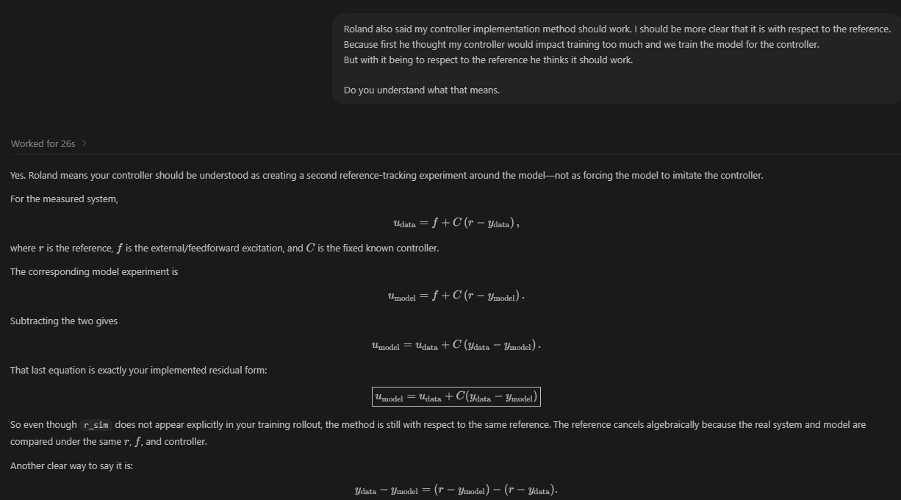
Reference
Thus the residual driving your controller is the difference between the model’s and system’s reference-tracking errors.

Slide 4
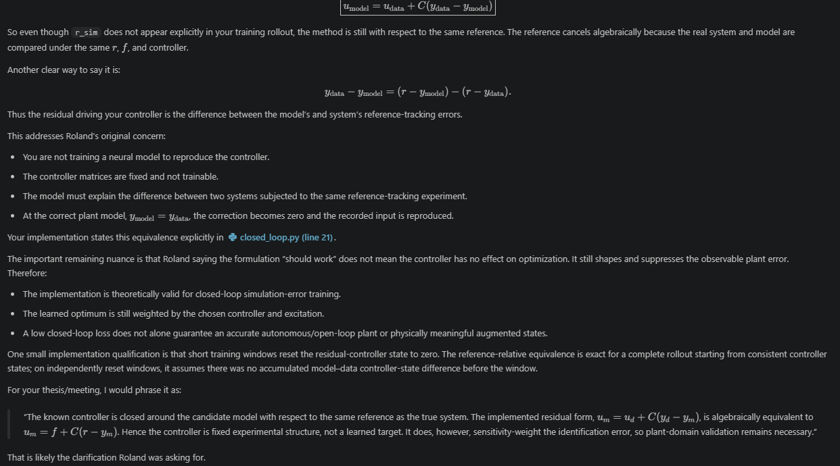
however, sensitivity-weight the identification error, so plant-domain validation remains necessary.

Slide 5
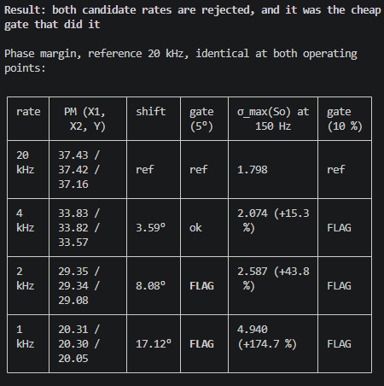
Downsampling controller
I don't think you need it, and the reason is the residual form above. What you need is not "the same controller", it is "a loop whose sensitivity shaping over the band you care about is close to the 20 kHz one". That is a testable claim, and the test is already written.

Slide 6
what do you think of this, is it false?:
The one-line version
The controller was never the cost driver. Every failure is about the model's rate. Downsampling the controller does almost nothing, good or bad; downsampling the model costs you phase margin in closed loop and metric resolution in open loop.
Axis 1: the controller rate
Not a lever in either direction.
┌────────────────┬───────────────────────┬─────────────────────┐
│ controller │ Cnorm phase at │ Dc factor │
│ rate │ crossover │ Cnorm(2/ts) │
├────────────────┼───────────────────────┼─────────────────────┤
│ 20 kHz │ 37.97° │ 0.1307 │
├────────────────┼───────────────────────┼─────────────────────┤
│ 4 kHz │ 37.98° │ 0.3701 │
├────────────────┼───────────────────────┼─────────────────────┤
│ 1 kHz │ 38.06° │ 0.454 │
└────────────────┴───────────────────────┴─────────────────────┘
Cfb is Tustin, and Tustin is phase-accurate well below Nyquist. Between 20 kHz and 4 kHz the phase at crossover moves 0.006°. Even at 1 kHz it is 0.09°, against 17.1° from the model's hold. So the controller rate cannot buy or lose you margin.
It does move Dc by 2.83x, which is a feedthrough effect and shows up in the σ_max(So) column, not in phase.
Raising it instead (multirate, controller fast, model slow) fails for a different reason: a 20 kHz controller needs y_data[k] - y_model[k] at 20 kHz, and y_model does not exist between model samples. Half the loop cannot be upsampled. You would interpolate it, which either leaves the residual piecewise constant at the model rate anyway or fabricates content that was never there. up_sample does not rescue this either: blocks.py:564-570 sub-steps RK4 with u held constant, so it buys integration accuracy inside the interval, not a finer input.
Axis 2: the model, closed loop
This is where it actually breaks. Two independent reasons.
Reason 1, phase margin from the input hold. Measured against 20 kHz, gate is 5°:
┌──────┬──────────────────┬────────┬───────────────────┬──────┐
│ rate │ PM (X1, X2, Y) │ shift │ 180·fc/fs │ gate │
│ │ │ │ prediction │ │
├──────┼──────────────────┼────────┼───────────────────┼──────┤
│ 4 │ 33.83 / 33.82 / │ 3.59° │ 3.6° │ ok │
│ kHz │ 33.57 │ │ │ │
├──────┼──────────────────┼────────┼───────────────────┼──────┤
│ 2 │ 29.35 / 29.34 / │ 8.08° │ 8.1° │ fail │
│ kHz │ 29.08 │ │ │ │
├──────┼──────────────────┼────────┼───────────────────┼──────┤
│ 1 │ 20.31 / 20.30 / │ 17.12° │ 17.1° │ fail │
│ kHz │ 20.05 │ │ │ │
└──────┴──────────────────┴────────┴───────────────────┴──────┘
The match to the ZOH half-sample lag is what makes this decisive. It is not a Tustin artefact at the 10ω = 1000 Hz roll-off pole (whose image walks +0.729 → +0.120 → -0.222 → -0.517 across the rates). It is pure delay from holding u across the model step, so no discretisation method, anti-alias filter, or faster controller recovers it. At fc = 100 Hz a 5° budget floors the model rate at roughly 3.5 kHz.
Reason 2, the sensitivity peak lands on the target. σ_max(So) at 150 Hz, which is cfg.fa, the hidden MSD frequency:
1.798 (20 kHz) → 2.074 (4 kHz) → 2.587 (2 kHz) → 4.940 (1 kHz)
A 2.75x change in how heavily the objective weights the exact mode the augmentation exists to learn. Note this gate flags at 4 kHz too (+15.3 %), and D-141 accepted that as a stated bias, so it is a bias reporter rather than a pass/fail. The phase-margin gate is the one 4 kHz passed and the low rates fail.
Untested but real, and only moot because the above already decided it: aliasing. The naive decimation (y[::D], block mean on u, data.py:78-104) is justified by a frac_above measured at the 2 kHz Nyquist. That does not transfer to 500 Hz, and the truth sim has Coulomb friction, which is broadband.
Axis 3: the model, open loop
This one does not fail technically. 800 Hz is precedented: D-136 floored the sweep there and excluded 400 Hz (Nyquist 200 Hz against a 180 Hz band top), D-137 ran the standalone ANN at 800 Hz on the finding that rate is information-neutral.
It fails economically, on the metric.
┌───────────────┬───────────────┬───────────────┬────────────┐
│ │ baseline │ oracle │ headroom │
│ │ (deriv6) │ (deriv8) │ │
├───────────────┼───────────────┼───────────────┼────────────┤
│ closed loop, │ 2.185e-06 to │ 2.780e-08 to │ 76.9 to │
│ aggregate │ 2.198e-06 │ 2.842e-08 │ 79.0 │
├───────────────┼───────────────┼───────────────┼────────────┤
│ closed loop, │ │ │ 107.4 to │
│ Y │ │ │ 108.4 │
├───────────────┼───────────────┼───────────────┼────────────┤
│ open loop, Y │ │ │ 2.35 │
└───────────────┴───────────────┴───────────────┴────────────┘
Like for like on Y that is a 46x loss of resolving power. Mechanism, two-sided:
- Denominator, the big part. Open loop the K=0 axes integrate initial-state and low-frequency error. Both models do this, so it is common-mode and does not discriminate. The loop annihilates it: σ_max(So) is 0.0004 at 1 Hz, and D-142 measured encoder-init versus true-x0 spread at 0.003-0.005 %, a 393x to 371,000x reduction against open loop. The oracle falls to its numerical floor instead of carrying drift it shares with the baseline.
- Numerator, the smaller part. The absorber mismatch at 150 Hz reaches the output multiplied by |So| ≈ 2.
Plus a cautionary precedent: D-137's own title is "sampling rate is information-neutral, the horizon is the binding constraint". It went to 800 Hz and then needed nf = 3700, a 4.6 s horizon. The saving was spent on horizon, not banked.
What downsampling would actually improve
Worth stating so this reads as a trade and not a verdict:
- The encoder window gets better. na_nb = (6+2)·2+1 = 17 samples regardless of rate. At 4 kHz that is 4.25 ms, or 0.64 of a period of the 150 Hz mode it must reconstruct the state of. At 800 Hz it is 21 ms, or 3.2 periods. On that argument 4 kHz is arguably too high.
- The gradient path shortens. nf = nf_seconds/ts_new, so 400 steps at 4 kHz against 80 at 800 Hz. This is the prize you were after.
Where I could still be wrong
p2_rate_compare.py models the plant as plain ZOH, but the pipeline uses a per-hold block mean of u (data.py:78-91). A block mean represents the input at the interval centre while being applied across it, so the real pipeline's lag may be smaller than the half-sample figure and 17.1° may overstate it. That is checkable, and it is the one thing that could soften Reason 1. It does not touch Reason 2 or the open-loop metric argument.
Also unknown: whether D-141's zero-ANN replay gate at both rates was ever run. That is the measurement that would price the 4 kHz So bias off actual signals rather than off σ_max(So).
Logged as D-166 in docs/decisions.md:22. Say the word if you want this overview appended there too, or if you want me to chase either open question.
Second, and this is the binding one: open loop costs you the metric. D-142 measured the baseline-to-oracle headroom at 77-79x closed loop against 2.35x on Y open loop, and the reason is exactly the σ_max(So) ≈ 2.07 at 130-180 Hz that the rate table has been flagging. The waterbed that makes low rates unacceptable is the same waterbed that makes the augmentation visible. So "downsample further with no controller" is not a 5x speedup, it is a 5x speedup bought with a 33x reduction in the separation your selection metric can see.
Keep the closed-loop training path at 4 kHz and stop treating the sample rate as the speed lever, on both this answer and D-166. If you want a cheap low-rate arm, scope it as an open-loop pre-training or diagnostic stage at 800 Hz with the D-137 precedent attached, and say up front that its numbers are not comparable to any closed-loop bestfit. Before that is worth building, let me price stride, n_seg and the n_seg > 1 closed-loop block, since that is where a 4x is likely to exist without giving up the metric.

Slide 7
How similar to kessels is my controller method?

Slide 8
Float64 issues??
records the direct-versus-residual gap as 2.62e-14 m in float64 but 1.79e-03 m in float32 over 100 closed-loop steps.

Slide 9
what was your point here or is not relevant anymore?: Not absorbable:
M(2,2): the linear-in-Y term 2·ma·L0·Y = 1.010·Y. The baseline's yaw inertia depends on Y only through mh·Y², so no parameter setting produces a term linear in Y. Structurally outside the model class, and LPV in character.
Everything carrying delta_a: −ma·delta_a in M(1,2) and 2·ma·(Y+L0)·delta_a in M(2,2). This is the actual dynamic coupling, and it is what scaled 5x today.
short response.

Slide 10
Encoder window

Slide 11
Multi-rate-horizon
2. The premise is challenged by your own supervisorsThe route rests on Ribeiro Thm 1, O(N^3) in step count, to argue that holding N fixed makes a longer physical horizon free. But Beintema, Schoukens and Toth (ICLR 2023, App. 8.1 Eq. 23a) give L_enc = O(exp(2*T*dt*L_f/tau)), exponential in physical horizon. Hold N fixed and multiply T*dt by 5 and the first bound stays flat while the second grows.

Slide 12
Comparison to Jan
Jan’s MSD is stable and forgetting, so gradients through a 200-step rollout remain well behaved.
The gantry contains marginal/integrating dynamics and is trained through a controller, making long-horizon gradients more biased and poorly conditioned.
The augmented state initially affects the loss through a weak bootstrap path involving its writer, encoder, and output coupling.
Adam rescales small gradients, especially with our eps=1e-16, but it cannot repair gradients that are incoherent, vanishing through the computational path, or pointing toward a controller-hidden short-horizon correction.

Slide 13
Encoder + multiple shooting
Connect the different windows but we have encoder init at each window due to subnet
Controller start at 0 for each window: Kessels only does it once does not do BPPT
B found a hit. Weber, Gühmann & Seel, "FranSys: A Fast Non-Autoregressive Recurrent Neural Network for Multi-Step Ahead Prediction", IEEE Access 12:145130-145147, 2024, DOI 10.1109/ACCESS.2024.3473014, free at the Hannover repository. It cites Beintema 2023. An Estimator RNN maps past inputs and outputs to the Predictor RNN's initial state, and Eq. (6)-(9), the "state synchronization loss", penalise the difference between the estimator's state and the rolled-out state at every horizon step, weighted α_sync in Eq. (11). At p = n_p that is exactly our defect between consecutive encoder-initialised segments.

Slide 14
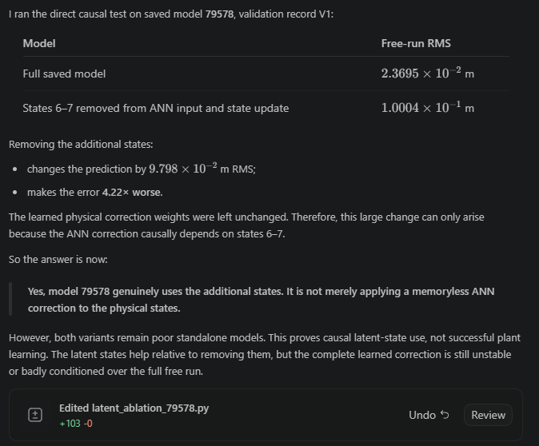
Worse mismatch between system and baseline model → ANN learns

Slide 15
The next useful change is therefore not “20 epochs at another rate.” It is to constrain selection or training with a model-sensitive criterion, such as open-loop held-out nf-RMS or standalone free-run stability, so the controller-hidden solution is no longer rewarded.

Slide 16
I have read all four reports and the corresponding additions in docs/references.md. The two research tracks fit together, but several conclusions need calibration before implementation.
Main conclusion
There are two distinct problems:
The controller makes optimization easier but makes the output loss less sensitive to plant error.
The current discrete ANN architecture is unsuitable for shared-rate continuous-time training and may also hinder long-term learning at one rate.
They should be addressed sequentially, not combined in one experiment.
Closed-loop objective
For the current residual loop,
\[ e_{\mathrm{CL}}=S\,d_{\mathrm{model}}, \qquad \Delta u_{\mathrm{fb}}=CS\,d_{\mathrm{model}}. \]
Therefore:
closed-loop output loss is suppressed where feedback is strong;
residual effort emphasizes some of those suppressed errors;
residual effort is not independent information because\[ \Delta u_{\mathrm{fb}}=C e_{\mathrm{CL}}; \]
it can improve conditioning, but cannot remove controller nullspaces or lack of excitation.
The literature supports residual effort under CLOE, CLIE and DIDIM terminology. The data-assimilation literature independently supports penalizing the injected correction so that the learned autonomous model must work after the injection is removed.
The best immediate experiment remains:
\[ L_{\mathrm{CL}} \quad\text{versus}\quad L_{\mathrm{CL}}+\lambda_uL_u \]
at 4 kHz and \(n_f=400\), with identical seeds and training conditions.
Before retraining, calculate \(L_u\) for initialization and 79578. That will directly establish whether its 38.7% closed-loop improvement required more residual force.
Important constraints:
normalize \(\Delta u_{\mathrm{fb}}\) with fixed, precomputed per-channel force scales;
never recompute the normalization from the candidate model;
log the state-dependent \(C_c\delta x_c\) and direct \(D_ce\) contributions separately;
do not use residual effort alone as proof of plant recovery;
retain held-out open-loop and standalone replay as deciding plant metrics.
What “closed-loop bias” means here
For the synthetic a5 dataset, classical statistical feedback bias is not the primary issue because there is effectively no measurement noise.
The current issue is better described as:
sensitivity weighting;
finite-experiment ambiguity;
controller-assisted or injection-assisted prediction;
optimization-geometry mismatch between controlled training and autonomous evaluation.
Kessels demonstrates that controller-wrapped training can work, but does not prove autonomous plant recovery for his industrial example.
Important correction about controller variation
A genuine changed-controller validation requires corresponding plant/output data generated or measured under that controller.
Simply replacing \(C\) with \(0.8C\) while comparing against the original \(C\)-generated trajectory is not equivalent to Kessels’ changed-controller test. It changes the counterfactual simulation without providing the corresponding physical target.
Therefore:
alternative-controller data can add information;
merely evaluating several simulated controllers against the same record cannot establish plant correctness;
multiple-controller training should remain deferred unless matching datasets are available.
Multi-rate findings
The exact Roland proposal was not found:
same trajectories decimated to several rates;
one shared continuous-time vector field;
fixed rollout step count;
longer physical horizon at coarse rates;
joint or scheduled rate losses;
shared plant parameters.
The closest source, Longi et al., uses the same record at multiple resolutions specifically to expose slow dynamics at fixed minibatch cost. However, it deliberately uses separate resolution-dependent latent components rather than one shared vector field.
So the proposal remains scientifically credible, but it is not an established recipe with a published weighting schedule or convergence guarantee.
The most important architectural result
The actual current model is approximately
\[ x_{k+1}=\Phi^{FP}_{T_s}(x_k,u_k)+g_\theta(x_k,x_{a,k},u_k), \]
with no \(T_s\) factor on the ANN.
That is a discrete per-step correction. It cannot represent the same physical dynamics at 4 and 2 kHz.
Even changing it to
\[ \Phi^{FP}_{T_s}(x_k,u_k)+T_sg_\theta(\cdot) \]
would only create a first-order split integration of the ANN correction. It would not retain RK4 accuracy because the physics/ANN interaction terms are missing.
The correct form is
\[ \dot z= \begin{bmatrix} f_{\mathrm{FP}}(x,u)+g_\theta(x,x_a,u)\\ g_{a,\theta}(x,x_a,u) \end{bmatrix}, \qquad z=[x;x_a], \]
with the entire combined vector field evaluated at every RK4 substage.
This should be implemented before shared-rate training. The literature strongly supports the structural conclusion. However, claims such as “three orders of magnitude accuracy defect” describe numerical order, not a measured gantry-error magnitude. A gantry-specific solver-refinement test is still required.
Recommended experimental order
Residual-effort audit of existing models
Compare initialization, 79534 and 79578:
  closed-loop output RMS;
  residual force RMS per channel;
  normalized effort;
  effort PSD near the absorber band;
  open-loop and standalone error.
Single-rate effort-loss ablation
At 4 kHz and \(n_f=400\):
\[ L_{\mathrm{CL}} \quad\text{vs}\quad L_{\mathrm{CL}}+\lambda_uL_u. \]
This isolates objective conditioning.
Continuous-time augmentation conversion
Put the physical and neural vector fields inside one RK4 integration. Verify equivalence at initialization and solver convergence after training.
Single 2 kHz open-loop premise test
Keep 400 steps, giving 0.2 seconds. This tests whether longer physical exposure helps the absorber dynamics.
It should be an open-loop coarse-rate test. The repository’s controller gate shows that a controller re-discretized at 2 kHz materially changes sensitivity and phase margin, so a 2 kHz closed-loop rung would confound horizon with a changed feedback system.
Only then test shared 4/2 kHz training
Requirements:
  shared continuous-time vector field;
  rate-specific encoders or an encoder conditioned on \(T_s/\tau\);
  equal physical normalization;
  common physical encoder-history duration;
  anti-aliasing and input semantics explicitly verified;
  coarse/fine gradient cosine logged;
  final evaluation at 4 kHz.
Do not include 800 Hz initially
At a 150 Hz relevant bandwidth, 800 Hz provides only 5.33 samples per cycle and fails the cited ten-times-bandwidth engineering guideline. It also increases decimation variance and alias/intersample risk.
Two literature conclusions I would not accept uncritically
First, the claim that “the fixed controller is the binding constraint, not the horizon” is too strong. A fixed controller can make the model non-discerning, while a short horizon can simultaneously prevent slow dynamics from becoming visible. Both can bind.
Second, the report’s blanket condemnation of block-mean \(u\) and point-sampled \(y\) is not yet established for this dataset. Block averaging is impulse-consistent for the recorded ZOH force, and previous project diagnostics showed that it removed severe marginal-axis error. The literature exposes a possible interchannel-delay/estimand problem, but a project-specific frequency and delay test is needed before changing the loader.
Working verdict
Residual effort: supported as a diagnostic and conditioning penalty, not independent plant information.
Open-loop auxiliary loss: the clearest autonomous-plant anchor, but potentially difficult to optimize; introduce only after the effort ablation or anneal it from zero.
Multi-rate horizon: plausible for long-term gradients, but unverified and currently blocked by the discrete ANN architecture.
Continuous-time combined RK4: the strongest architecture improvement supported by the searches.
Best immediate next action: calculate residual effort for initialization and 79578, then run the isolated 4 kHz effort-loss A/B.
Best subsequent horizon test: one 2 kHz open-loop rung, followed by 4 kHz evaluation, not a raw three-rate closed-loop ladder.
Relevant documents: [closed-loop objective review](C:\\Users\\20203253\\OneDrive - TU Eindhoven\\Graduation Project\\Baseline FP model\\Baseline-LPV-Augmentation\\docs\\closed-loop-objective-literature-2026-08-28.md), [closed-loop findings](C:\\Users\\20203253\\OneDrive - TU Eindhoven\\Graduation Project\\Baseline FP model\\Baseline-LPV-Augmentation\\docs\\closed-loop-training-findings-2026-08-28.md), [multi-rate sweep](C:\\Users\\20203253\\OneDrive - TU Eindhoven\\Graduation Project\\Baseline FP model\\Baseline-LPV-Augmentation\\docs\\multi-rate-shared-ct-model-sweep-2026-08-28.md), and [multi-rate findings](C:\\Users\\20203253\\OneDrive - TU Eindhoven\\Graduation Project\\Baseline FP model\\Baseline-LPV-Augmentation\\docs\\multi-rate-shared-ct-identification-findings-2026-08-28.md).

Slide 17
understand these literature searches for possible improvements to make the ANN learn either long term dynamics or train in closed-loop while not being biased by the closed loop or a better alternative found in the literature:
docs/multi-rate-shared-ct-model-sweep-2026-08-28.md
docs/closed-loop-objective-literature-2026-08-28.md,
[closed-loop-training-findings-2026-08-28.md](C:\\Users\\20203253\\OneDrive - TU Eindhoven\\Graduation Project\\Baseline FP model\\Baseline-LPV-Augmentation\\docs\\closed-loop-training-findings-2026-08-28.md)
[multi-rate-shared-ct-identification-findings-2026-08-28.md](C:\\Users\\20203253\\OneDrive - TU Eindhoven\\Graduation Project\\Baseline FP model\\Baseline-LPV-Augmentation\\docs\\multi-rate-shared-ct-identification-findings-2026-08-28.md)
these sources are updated in: docs/references.md

Slide 18
Open loop mismatch long horizon
Multi-rate-horizon??
Multiple shooting: connect different windows.
The meeting results also contain an important result I should have led with:
Open-loop run 79573 reduced its short-horizon nf-RMS from 2.4823e-4 to 1.1260e-4—about 54.6% improvement.
But its full-record open-loop selector did not improve: the best remained the epoch-zero 3.309e-3.
Closed-loop run 79578 improved its controller-assisted metric while its open-loop nf metric worsened to about 3.374e-4

Slide 20
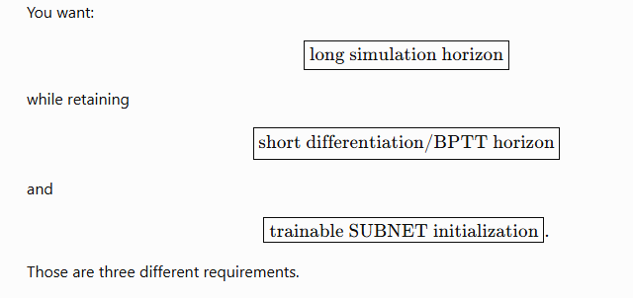
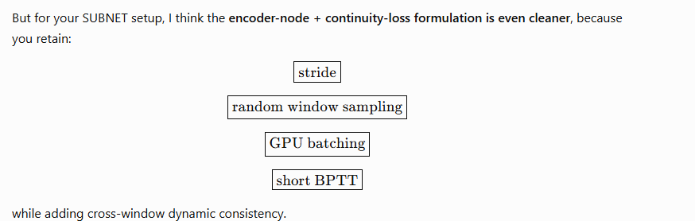
I really need a method to see long term dynamics with short windows. But I have a subnet encoder initializing the states because we do augmentation and need a trained encoder for that and we use subnet at the moment.
  Multiple shooting connecting the windows somehow while being able to use encoder init per window. Or maybe not per window but each x amount of windows…?
Then there is the bias the controller training is creating we have a run on the server for it..? Kessels was also not able to fix this.

Slide 21
multi-scale time-stepping
Hemmasian and Barati Farimani (multi-scale time-stepping) offers one idea worth knowing and probably not usable here: train several dynamical models at dt in {1, 2, 4, 8} with the same short rollout length R, so the physical span grows without gradient depth (their Algorithm 2 and the D^2 -> D^4 -> D^8 transfer-learning init). Applied here it would reach 0.8 s of span at nf = 400. It fails on our band: the augmentation target is the 130 to 180 Hz absorber, and coarsening Ts aliases the mode the ANN must learn. Worth one sentence in a related-work section, not worth building.

Slide 22
Closed loop does NOT expose long term dynamics → hides it
You’re right to push on this. The result does not say “remove the controller and hope open-loop works”; it says we need to keep the controller’s optimization benefit while preventing it from defining the plant-dynamics objective.

Slide 23
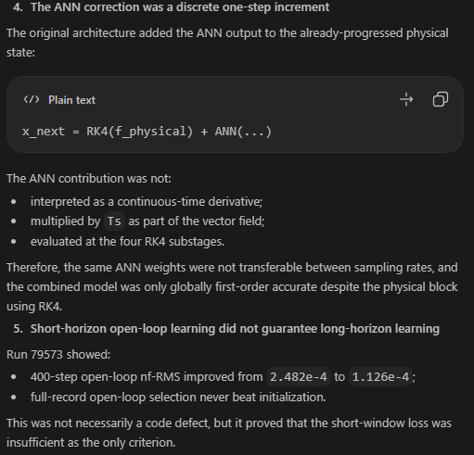
Issue ANN not for more sampling rates

Slide 24
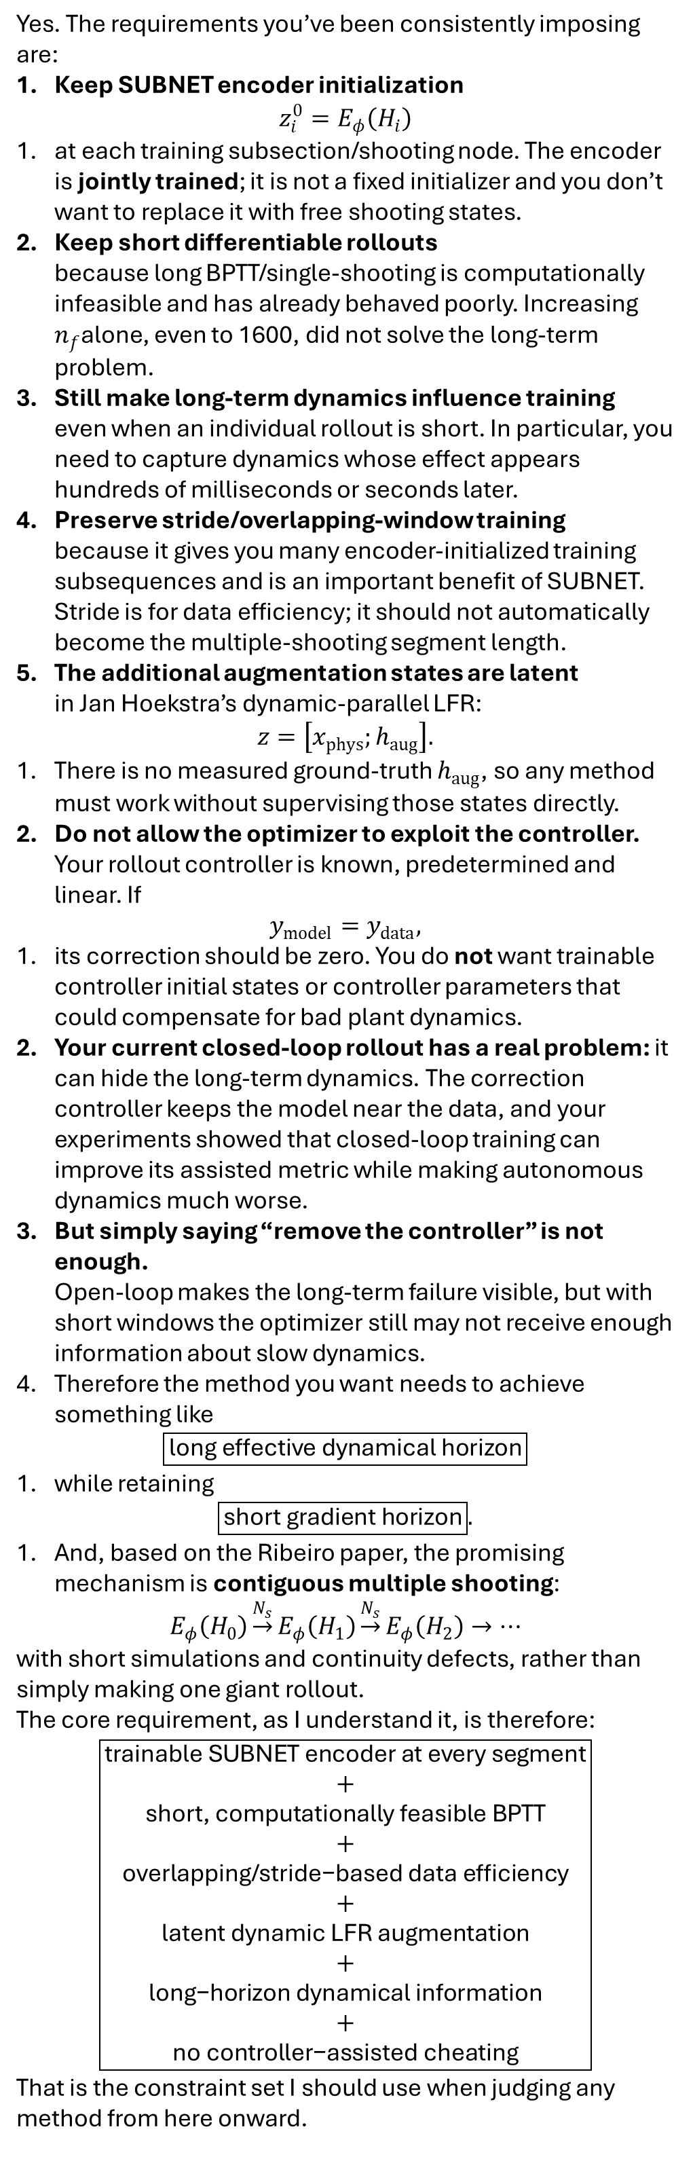
Requirements
Yes. The requirements you’ve been consistently imposing are:
Keep SUBNET encoder initialization
$$z_{i}^{0}=E_{φ}\left(H_{i}\right)$$
at each training subsection/shooting node. The encoder is jointly trained; it is not a fixed initializer and you don’t want to replace it with free shooting states.
Keep short differentiable rollouts
because long BPTT/single-shooting is computationally infeasible and has already behaved poorly. Increasing $n_{f}$alone, even to 1600, did not solve the long-term problem.
Still make long-term dynamics influence training
even when an individual rollout is short. In particular, you need to capture dynamics whose effect appears hundreds of milliseconds or seconds later.
Preserve stride/overlapping-window training
because it gives you many encoder-initialized training subsequences and is an important benefit of SUBNET. Stride is for data efficiency; it should not automatically become the multiple-shooting segment length.
The additional augmentation states are latent
in Jan Hoekstra’s dynamic-parallel LFR:
$$z=\left[x_{phys} ; h_{aug}\right].$$
There is no measured ground-truth $h_{aug}$, so any method must work without supervising those states directly.
Do not allow the optimizer to exploit the controller.
Your rollout controller is known, predetermined and linear. If
$$y_{model}=y_{data},$$
its correction should be zero. You do not want trainable controller initial states or controller parameters that could compensate for bad plant dynamics.
Your current closed-loop rollout has a real problem: it can hide the long-term dynamics. The correction controller keeps the model near the data, and your experiments showed that closed-loop training can improve its assisted metric while making autonomous dynamics much worse.
But simply saying “remove the controller” is not enough.
Open-loop makes the long-term failure visible, but with short windows the optimizer still may not receive enough information about slow dynamics.
Therefore the method you want needs to achieve something like
$$\boxed{\text{long effective dynamical horizon}}$$
while retaining
$$\boxed{\text{short gradient horizon}}.$$
And, based on the Ribeiro paper, the promising mechanism is contiguous multiple shooting:
$$E_{φ}\left(H_{0}\right)\underset{→}{N_{s}}E_{φ}\left(H_{1}\right)\underset{→}{N_{s}}E_{φ}\left(H_{2}\right)→⋯$$
with short simulations and continuity defects, rather than simply making one giant rollout.
The core requirement, as I understand it, is therefore:
$$\boxed{\begin{matrix}\text{trainable SUBNET encoder at every segment} \\ + \\ \text{short, computationally feasible BPTT} \\ + \\ \text{overlapping/stride−based data efficiency} \\ + \\ \text{latent dynamic LFR augmentation} \\ + \\ \text{long−horizon dynamical information} \\ + \\ \text{no controller−assisted cheating}\end{matrix}}$$
That is the constraint set I should use when judging any method from here onward.

Slide 25
Before the literature: two numbers in your setup decide most of this, and I'd want them stated explicitly in the thesis.
(i) What is $n_f = 1600$ in seconds? On a gantry stage sampled at 10 kHz that is 160 ms, i.e. you never actually tested the 1–4 s regime and the "increasing $n_f$ didn't help" evidence is not evidence about long horizons at all. At 1 kHz it is 1.6 s and the evidence is meaningful. (ii) What is the encoder history $H_i$ in seconds? If the slow augmented mode has a 1–4 s time constant and $H_i$ spans 5–50 ms, the reconstructability map you are asking $E_\phi$ to approximate is numerically singular in exactly the direction you care about, and no change to the loss horizon will fix it.
1. Diagnosis first
There is a fifth mechanism you did not list, and I think it dominates.
E. Criterion-level masking by the encoder itself. The controller is not the only thing resetting your model toward the data. The encoder is. SUBNET re-initializes $z_i^0 = E_\phi(H_i)$ at every subsection, which is structurally an observer reset every $n_f$ samples. A model that is right over 100–400 ms and wrong over 1–4 s can drive the SUBNET criterion to its noise floor, because the criterion never lets the wrong mode run. This is the nonlinear-state-space version of the classical observation that a criterion with output injection (one-step or short-horizon prediction error) selects different models than a simulation criterion, and that autoregressive/feedback terms let a structurally wrong model look good. Piroddi shows that one-step prediction-error minimisation can select incorrect or redundant structures, particularly when the data are not adequately exciting or are oversampled, and that a simulation-error criterion is the more effective alternative. Your controller experiment is a second, stronger instance of the same effect.
Ranking the mechanisms for your case:
A (optimization horizon). Unlikely to be the whole story, provided $n_f=1600$ was genuinely seconds. Ribeiro et al. show the loss Lipschitz constant can grow exponentially with the simulation interval length, so A is real, but A predicts "training becomes unstable/stuck", not "training converges nicely to a model with wrong slow dynamics".
B (state reconstruction). High prior probability, cheap to test, and it is the one failure that cannot be repaired by any loss-side change. If $H_i$ does not span the slow time constant, $E_\phi$ returns an essentially arbitrary $h_\mathrm{aug}$, and the slow-mode parameters receive gradient dominated by encoder noise.
C (supervision/information). High prior probability. Quantitatively: a slow-eigenvalue error $\delta$ with modal amplitude $a$ produces output deviation $\approx a,\delta,t$. Over a window $\tau_s = n_f T_s$ the signal energy is $\propto a^2\delta^2\tau_s^3$; over $T$ it is $\propto a^2\delta^2T^3$. Short windows suppress slow-mode information by $(\tau_s/T)^3$. With $\tau_s = 0.16$ s and $T = 4$ s that is $6\times10^{-5}$.
D (structural identifiability). Plausible given your architecture history (the marginally-stable-Jacobian and zero-gradient-block episodes suggest the augmentation block's slow dynamics are weakly coupled to $y$). Test it directly rather than assuming it.
The single most informative fact you already have: the model fits short windows well and drifts long-term reproducibly. That pattern is C/D, not A.
2. Your six multiple-shooting questions, answered
Q1/Q2: does encoder-generated multiple shooting preserve what constrained MS provides? No, and the reason is exact.
In classical MS with free shooting variables $s_i$ and hard constraints $s_{i+1} = F_\theta^{N_s}(s_i)$, the Lagrangian stationarity condition in $s_i$ is
$$ \lambda_i ;=; \frac{\partial \ell_i}{\partial s_i} + \Phi_i^\top \lambda_{i+1}, \qquad \Phi_i = \frac{\partial F_\theta^{N_s}}{\partial s_i}, $$
and the parameter gradient is $\nabla_\theta L = \sum_i \big[\partial_\theta \ell_i + (\partial_\theta F^{N_s}i)^\top \lambda{i+1}\big]$. That multiplier recursion is the BPTT adjoint of the full-length trajectory. At a feasible KKT point the reduced gradient equals the long single-shooting gradient. This is the precise sense in which constrained MS buys long-horizon sensitivity with short graphs: the horizon lives in the multipliers, not in the computational graph.
Substituting $s_i = E_\phi(H_i)$ destroys this. $E_\phi(H_{i+1})$ depends on data and $\phi$ only, so $\partial_\theta E_\phi(H_{i+1}) = 0$ and there is no backward recursion linking segment $i$ to segment $i+1$. The stationarity conditions in ${s_i}$ are replaced by one pooled condition on $\phi$. The effective dynamical horizon of an encoder-anchored defect term is $N_s$, full stop. What encoder-MS actually buys you is different and still worth having: supervision on the full state, including the unmeasured $h_\mathrm{aug}$, instead of supervision only through $C$. That is a state-space gain, not a horizon gain.
Beintema is explicit that SUBNET is the encoder-based reformulation of MS: the subspace encoder estimates each section's initial state directly from past inputs and outputs so complexity does not grow with the number of sections, and unlike standard multiple shooting the formulation uses overlapping subsections, which is proven to increase data efficiency. So adding a defect penalty on top of SUBNET does not turn SUBNET into Ribeiro's method. It adds a latent-state consistency term to something that is already amortized MS.
Q3: can the encoder absorb the defects? Yes, and there is a named degenerate manifold. Any pair $(E_\phi, F_\theta)$ satisfying $E_\phi \circ \text{shift}^{N_s} = F_\theta^{N_s}\circ E_\phi$ on the training data has zero defect regardless of whether $F_\theta$ matches the plant. Concretely, in your architecture the optimizer can set $E_\phi$'s $h_\mathrm{aug}$ output to (near) zero and let $A_\mathrm{aug}$ be anything: $h_\mathrm{aug}$ stays near zero along all trained rollouts, defects vanish, output loss is unchanged, and the autonomous long-horizon behaviour is whatever $A_\mathrm{aug}$ happens to be. The degeneracy lies exactly along the direction you are trying to identify. Any defect penalty needs a latent normalization (fix the scale of $h_\mathrm{aug}$ or of $C_\mathrm{aug}$) or it is unfalsifiable. The GOKU-net authors hit the same wall: in latent models the dynamics live in a space being learned simultaneously, so the true initial conditions per window are unavailable, unlike settings where the ODE models the observed data directly.
Q4: coherent accumulation. This is the decisive calculation. With eigenvalue error $\delta$, per-segment defect $\approx a,\delta,\tau_s$, $K = T/\tau_s$ segments, and per-defect noise $\varepsilon$ (encoder estimation error, which is not small for a weakly observable slow state):
$$ \text{SNR}^2_{\text{defect}} = \frac{K,a^2\delta^2\tau_s^2}{\varepsilon^2} = \frac{a^2\delta^2,\tau_s T}{\varepsilon^2} \quad\Longrightarrow\quad \delta_{\min}^{\text{MS}} \propto \frac{\varepsilon}{a\sqrt{\tau_s T}}, $$
against long single shooting with per-sample output noise $\sigma$:
$$ \delta_{\min}^{\text{SS}} \propto \frac{\sigma\sqrt{T_s}}{a,T^{3/2}} . $$
The defect criterion sums squares (incoherent); the long-horizon criterion squares a sum (coherent). The detectability gap is a factor $\sim T/\sqrt{\tau_s}$. Re-weighting the penalty by $\mu$ rescales the deterministic term but not this ratio, because $\varepsilon$ scales with it. Small coherent defects are not recoverable by turning up $\mu$.
Q5: yes, the literature exists, and it is the closest thing to your setting. Iakovlev et al. propose a principled multiple-shooting scheme for neural ODEs that splits trajectories into short segments optimized in parallel with probabilistic control of continuity across segments, with amortized encodings of the segment initial states via a transformer recognition network; the follow-up extends this to latent PDE states with a purpose-built encoder. That is amortized/encoder-generated shooting with a probabilistic continuity prior rather than a hard constraint. Note what they claim: efficient and stable training on long, irregularly sampled trajectories. They claim optimization stability, not recovery of long-horizon identifiability. Their guarantee does not transfer to your question.
Q6: penalty vs augmented Lagrangian vs exact constraints. Turan and Jäschke note the MS continuity constraints can be handled by a penalty or an augmented Lagrangian method, and Chakraborty et al.'s MP-NODE uses $\mathcal{L} = \mathcal{L}_{GT} + \tfrac{\mu}{2}\mathcal{L}_P$ with $\mathcal{L}P$ the mean squared discontinuity across windows. An augmented Lagrangian is strictly better than a pure penalty if your shooting states are free, because the explicit multipliers restore the cross-segment adjoint recursion at moderate $\mu$. With encoder-generated states there are no multipliers to propagate, so the augmented Lagrangian degenerates to a penalty with an adaptive weight. If you want the AL to buy you anything, you must free the shooting states, which breaks your requirement 1. A defensible middle path is a hybrid: $s_i = E\phi(H_i) + \Delta_i$ with free, regularized $\Delta_i$ only at a coarse grid of segment boundaries. That preserves the encoder as the reconstructability map and as the initializer, keeps $O(n_z \times K)$ extra variables rather than one per overlapping window, and restores the multiplier chain. It is a modest, explainable deviation, not a new algorithm.
3. The controller
Linearize about the rollout, let $G_\theta$ be the model's frozen-scheduling response and $K$ the fixed controller. With $u_\mathrm{corr} = K e$, the training residual is
$$ e_{\mathrm{cl}} = \underbrace{(I + G_\theta K)^{-1}}{S},e{\mathrm{ol}} . $$
Your masking is quantitatively $|S(j\omega)|$, which is smallest exactly in the low-frequency band where your 1–4 s dynamics live. This is not a tuning problem; it is what a stabilizing loop does. So requirement 6 is satisfied only if you either drop the controller or invert $S$ in the criterion. The inversion is available in closed form because $K$ is known:
$$ e_{\mathrm{ol}} = S^{-1}e_{\mathrm{cl}} = e_{\mathrm{cl}} + G_\theta,u_{\mathrm{corr}}, \qquad J = \sum_k \big| e_k + (G_\theta u_{\mathrm{corr}})_k \big|^2 . $$
In words: the corrective control action is the model error, mapped through the loop. Penalizing the residual plus the model's response to the correction recovers the open-loop error, and $J = 0$ iff the model is autonomously correct. Exact for the linearized/frozen-scheduling case, approximate for the LPV/LFR case, and it costs one extra short rollout. If you keep the controller, this is the only version I would defend in a thesis. Otherwise drop it from training and use it only for rollout stabilization during evaluation.
4. Methods screened and rejected
Weak-form / collocation / WSINDy. Gives long-horizon information without BPTT, but requires the state (or its derivatives) to be measured. Your $h_\mathrm{aug}$ is not. Violates requirement 5.
Adjoint / checkpointing. Solves memory, not conditioning. The exponential growth of loss Lipschitz constant with interval length is untouched. Violates the spirit of requirement 2 (compute is still $O(T)$).
Latent overshooting (Hafner et al.). It enforces consistency between one-step and multi-step predictions in latent space, but the gradient horizon equals the overshoot horizon. It is $n_f$ under another name.
Curriculum MS / MP-NODE. Curriculum multiple shooting combines curriculum learning with multiple shooting for ODE fitting and MP-NODE splits trajectories into non-overlapping windows and penalizes inter-window discontinuities. Both are mechanism-A medicine, and both drop overlapping windows. Useful as a fallback if your diagnostic says A; not otherwise.
Synthetic/decoupled gradients. No system-identification track record, no guarantee, unfalsifiable in a thesis timeframe. Reject.
5. The three I would defend
R1. Frequency-weighted (prefiltered) SUBNET criterion
Reference. Ljung, System Identification: Theory for the User, 2nd ed., Ch. 8 (bias distribution) and Ch. 14 (prefiltering); Forssell & Ljung, Closed-loop identification revisited, Automatica 35(7), 1999, for the sensitivity-weighting argument.
What it solves. It shows the asymptotic parameter bias is $\theta^\star = \arg\min\int |G_0 - G_\theta|^2 |L|^2 \Phi_u/|H|^2,d\omega$: the criterion's frequency weighting determines which dynamics get fitted, and a prefilter $L$ moves that weighting.
Equation. Replace $e_k$ by $(L e)_k$ with $L$ a low-pass or band-emphasis filter covering $0.25$–$10$ rad/s, applied to both $y^{\mathrm{data}}$ and $y^{\mathrm{model}}$ inside each subsection (with filter states carried from the encoder history to avoid a filter transient).
Assumptions. LTI model class, open-loop, quadratic criterion, asymptotic in $N$.
Differs from yours. Nonlinear/LPV model, truncated segments, encoder resets. The bias formula becomes local (per frozen scheduling), not global.
Transfers. The qualitative statement that short-window broadband criteria under-weight low-frequency dynamics, and that prefiltering re-weights them. This is standard and your supervisors will accept it immediately.
Does not transfer. Any quantitative bias guarantee.
How long-term dynamics enter the gradient. They do not enter through horizon; they enter through weighting. A 1 s time constant is a $\sim$1 rad/s spectral feature, and its signature is present within a 160 ms window as a low-frequency trend, just at low SNR relative to the broadband error. $L$ raises that SNR. This is the coherent-averaging escape from the $\delta_{\min}$ argument in Q4: averaging happens across the whole record in frequency, not within a window in time.
Cost. One filter. No change in memory or graph depth.
Failure modes. If the window is shorter than one period of the mode of interest, the filter cannot manufacture information that is not in the window ($n_f T_s \gtrsim 2\pi/\omega_{\mathrm{slow}}$ is a hard floor). Also fails outright if the mechanism is B.
Falsifying experiment. Loss-landscape slice (below) with and without $L$. If curvature along the slow-mode direction does not increase by an order of magnitude, drop R1.
R2. Local-FRF / BLA matching on the LFR linearization
Reference. Pintelon & Schoukens, System Identification: A Frequency Domain Approach, 2nd ed.; and for your exact model class, Schoukens & Tóth, "On the initialization of nonlinear LFR model identification with the best linear approximation", IFAC World Congress 2020.
What it solves. Extracting a linear dynamic description of a nonlinear LFR system from data and using it to place the linear dynamics of the LFR block.
Equation. At frozen scheduling $p$, your LFR augmented model is LTI with $(A(p),B(p),C(p),D(p))$ obtained from the loop matrix $L(Y) = I - D_{zw}\Delta(Y)$ you already audited. Add $J_{\mathrm{FRF}} = \sum_{p}\sum_{\omega\in\Omega_{\text{slow}}} W(\omega),|\hat G_p(j\omega) - C(p)(j\omega I - A(p))^{-1}B(p) - D(p)|^2$, with $\hat G_p$ from local excitation experiments or a BLA. Gradients are analytic; no rollout at all.
Assumptions. Local linearizations are meaningful, and you can obtain $\hat G_p$ at operating points.
Differs from yours. Your gantry may not be re-excitable at will after the hardware move.
Transfers. The identifiability argument: poles and damping at 0.25–10 Hz are directly supervised. This is the only candidate that attacks D as well as C.
Does not transfer. Nothing about the nonlinear coupling between operating points.
Gradient path. Through $A(p)$'s eigenstructure, with zero BPTT depth.
Cost. Negligible per step. Data collection is the cost.
Failure modes. No usable low-frequency excitation in the archived dataset; scheduling-dependent linearizations not identifiable from the available operating points.
Falsifier. Compute $\hat G_p$ from your existing data at the slowest available operating condition and overlay the trained model's frozen linearization. If the slow poles already match and long-term simulation is still wrong, R2 is dead and the problem is not in the linear dynamics.
R3. Boundary-corrected encoder shooting with augmented Lagrangian
Reference. Bock & Plitt (1984) for MS; Turan & Jäschke (2022) for penalty/AL handling of the continuity constraints in neural DE training; Iakovlev et al. (ICLR 2023) for the amortized/encoder-generated shooting-state variant with probabilistic continuity.
What they solve. Loss-landscape smoothing and stable training on long trajectories.
Equation. $s_i = E_\phi(H_i) + \Delta_i$ on a coarse boundary grid; $d_i = s_{i+1} - F_\theta^{N_s}(s_i)$; $\mathcal{L} = \sum\ell_i + \sum\lambda_i^\top d_i + \tfrac{\mu}{2}\sum|d_i|^2$ with the standard multiplier update $\lambda_i \leftarrow \lambda_i + \mu d_i$. Latent scale must be pinned (fix $|C_\mathrm{aug}|$ or normalize $h_\mathrm{aug}$ variance) or see Q3.
Assumptions. Free shooting variables; convergence to a near-feasible point.
Differs. Yours are encoder-anchored, which is why $\Delta_i$ is needed.
Transfers. Smoothness (Ribeiro), and with $\Delta_i$ free, the multiplier recursion.
Does not transfer. Nothing if you keep the states fully encoder-pinned, per Q1/Q2.
Gradient path. Through $\lambda_{i+1}$, which accumulates $\Phi_i^\top$ backwards across segments.
Cost. $n_z \times K$ extra variables plus multipliers, $K$ = number of boundaries, not number of windows. Overlapping windows survive because they are the $\ell_i$ terms, not the boundaries.
Failure modes. $\Delta_i$ absorbs the model error instead of exposing it if unregularized; AL is sensitive to the $\mu$ schedule; adds real implementation risk.
Falsifier. Train on a synthetic twin with a known slow mode, deliberately mis-set, and check whether the multipliers move $\theta$ toward truth.
6. Ranking
Honest verdict: no established method satisfies all seven of your requirements with a transferring guarantee. Requirements 1, 2 and 3 are close to mutually exclusive in the time domain, because the encoder reset is itself what destroys long-horizon information. Every method above escapes by relaxing something: R1 and R2 move the long-horizon information out of the time domain; R3 relaxes requirement 1 slightly. Anyone who tells you encoder-anchored multiple shooting recovers Ribeiro's long-horizon equivalence has not written down the multiplier recursion.
Recommended first experiment
A loss-landscape slice along the slow-mode direction. No training, one afternoon.
Take your current trained model. Pick a scalar perturbation $\delta$ that moves only the slow augmented eigenvalue (or the corresponding $A_\mathrm{aug}$ entry), spanning a range wide enough that the 4 s autonomous simulation is visibly wrong at the ends. For each $\delta$, evaluate, with everything else frozen:
the SUBNET loss at $n_f \in {100, 400, 1600}$;
the same with the corrective controller on and off;
the same with a low-pass prefilter $L$ applied to the residual;
the true 4 s autonomous simulation error.
Then compare curvatures $\partial^2 J/\partial\delta^2$ at $\delta = 0$.
This single sweep separates everything. Flat SUBNET loss but sharp 4 s error means C, and A is excluded (there is nothing to optimize toward). Curvature that grows properly with $n_f$ means A. Curvature that collapses when the controller is on quantifies the masking as $|S|^2$ and settles requirement 6 empirically. Curvature that recovers under $L$ validates R1 before you implement anything. And plot $E_\phi$'s output along the sweep: if the encoder's $h_\mathrm{aug}$ estimate is uncorrelated with the true slow state of the perturbed model, you have B, and no loss-side method will help.
Run the encoder-window check in the same session: re-train (or just re-fit $\phi$ with $\theta$ frozen) with the history span doubled and quadrupled, using dilated/decimated taps so the parameter count stays flat. If B is present this is the cheapest fix in the entire document.
Recommended thesis-safe solution
R1, plus removing the corrective controller from training (or replacing the residual by $e + G_\theta u_\mathrm{corr}$). It is a change to the criterion's frequency weighting, not to the training architecture. SUBNET, the encoder, overlapping windows, stride, $n_f$, memory scaling, and your LFR realization all stay exactly as they are. The justification is textbook, your supervisors work in that tradition, and the failure mode is bounded and stateable ("the window must contain at least one period of the mode being weighted"). You can write the bias-distribution argument, the sensitivity-inversion derivation, and the landscape sweep as a coherent three-part chapter that stands even if the final model is imperfect.
Strongest alternative
R2, the FRF/BLA-matching auxiliary loss. It is the only option that gives direct, gradient-bearing supervision of the augmented model's slow poles and damping with no rollout at all, and the only one that touches mechanism D. Use it as an added term rather than a replacement, weighted so it does not dominate the time-domain fit. If both R1 and R2 fail, that is itself a strong thesis result: it says the slow behaviour is not a linear-dynamics property of the augmentation, and the model-class question (D) becomes the contribution, at which point R3 on a synthetic twin is the right way to demonstrate it rather than a fix to be shipped.
Method | Long effective horizon with short BPTT? | Keeps trained encoder? | Works with latent states? | Keeps overlapping windows? | Prevents controller masking? | Literature support | Main unresolved risk
R1 Frequency-weighted / prefiltered SUBNET loss (+ $S^{-1}$ weighting or no controller) | Yes, via spectral weighting rather than horizon | Yes, unchanged | Yes, no latent targets needed | Yes | Yes, $L = I + G_\theta K$ inverts the loop exactly in the linearized case | Very strong (Ljung Ch. 8/14; Forssell & Ljung 1999); classical, uncontroversial | Cannot exceed the information in one window: needs $n_f T_s \gtrsim$ one period of the slow mode
R2 Local-FRF / BLA matching on the LFR linearization | Yes, zero BPTT; a 1 s constant is a 1 rad/s feature | Yes, orthogonal to it | Yes, supervises $A_\mathrm{aug}$ spectrum, not $h_\mathrm{aug}$ values | Yes | Yes, no rollout to corrupt | Strong, and in your supervisors' own line (Schoukens & Tóth 2020 on LFR + BLA) | Requires low-frequency excitation at usable operating points; hardware was relocated
R3 Boundary-corrected encoder shooting + augmented Lagrangian | Partially; only if $\Delta_i$ are free so multipliers chain | Yes, as anchor and initializer | Yes, with latent scale pinned | Yes, boundaries decoupled from windows | Only if controller removed | Moderate (Bock & Plitt; Turan & Jäschke; Iakovlev) | The consistent-hallucination manifold of Q3; AL tuning; highest implementation risk

Slide 26
The controller was never supervision. It was stabilization.
The good core idea is:
If feedback mainly helps by preventing unstable training rollouts, replace it with data-independent stability.

Slide 27
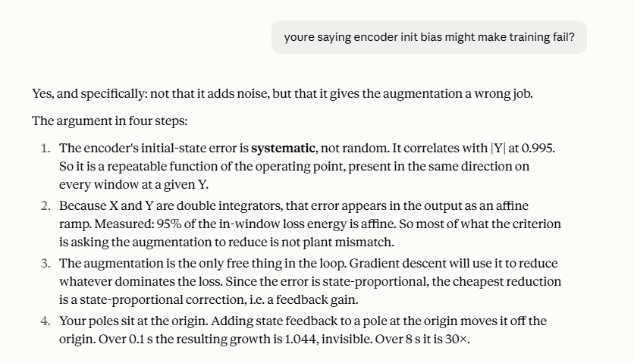
Is encoder bias making training fail?

Slide 29
Hypothesis causing augmentation NOT to learn

Slide 30
That the closed-loop objective causes bad open-loop plant estimation (380x worse than the untrained baseline) and that this is a separate failure from the window-to-free-run gap, which persists unchanged in open loop where no controller exists.

Slide 31
how do we PROOF this?: so a near-DC offset ε accumulates as t²/2 with no restoring force

Slide 32
Established: there exists a single scalar, the time-averaged ANN output on dX, whose removal recovers two thirds of the open-loop degradation and which the training loss cannot see at all. That is a mechanism, measured on frozen weights.

Slide 33
Verdict hypothesises
Verdicts:(1) Alive, and now the best-evidenced thing in the log. It survived in a sharper form than you posed it: not "the window is too short" generically (nf sweeps to 3200 and the black-box at nf=800 both failed), but the loss is blind to a specific component. §19 proved the blindness from the plant and horizon alone, §21 found the component (dX mean, 67-68 % of the damage at a windowed cost in the third decimal), and 79573 shows the window improving 2.2x while the free run degrades 28x with no controller present. This is where the remaining work is.(2) Confirmed, and closed as a question. 79534 vs 79573, one knob: closed-loop training gives an open-loop plant 380x worse than doing nothing, at NRMS 1.80. Your phrasing was right. There is nothing left to investigate here, only to decide what objective replaces it. Note the qualifier that came out of the same pair: it is not the whole story, because the window-to-free-run failure persists in open loop.(3) Dead. Drop it. Three independent strikes: the 2026-08-02 exact-IC run, D-167 fixing the X-pair encoder up to 10.9x while X stayed the fastest-degrading axis, and now the trained encoder halving the free-run error (4.63e-3 untrained → 2.20e-3 trained). The encoder is helping.
1. Short windows cannot observe long-term dynamics.
2. The controller was never supervision, it was stabilisation. Closed loop hides long-term dynamics and makes the model worse open-loop, so bad plant dynamics get learned and the controller compensates.
3. Bad encoder init on the initial states, so the model learns something bad on top of it.
- Established: closed-loop training wrecks the open-loop plant (one-knob intervention). The loss is blind to the dX mean, which carries ~68 % of the damage on both production-rate checkpoints.- Dead: encoder init.- Caveat on everything in §20-22: closed-loop checkpoints only.

Slide 34
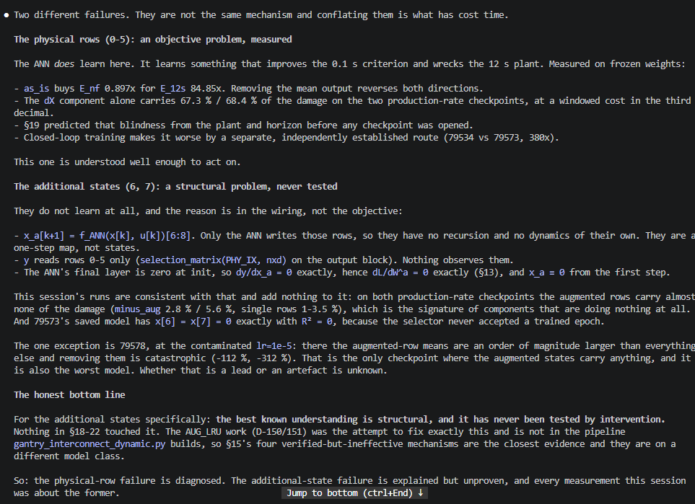

Slide 35
❯ so in short what is the current status / main hypothesis?
Two independent failures, both measured.1. Physical rows: the objective trades the plant for the window. The ANN learns here, and what it learns improves the 0.1 s loss while wrecking the 12 s free run. One scalar, the mean ANN output on dX, carries 67-68 % of the open-loop damage on both production-rate checkpoints and costs the loss nothing (0.8969 → 0.8972). Closed-loop training compounds it by a separate, independently established route (380x worse open-loop, one-knob intervention).2. Augmented states: structurally inert, never learned. At init dy/dx_a = 0 and dL/dW^a = 0 exactly, x_a[k≥1] = 0 exactly. After training, deleting them improves the free run by 2.2 % and 4.8 %. The R² of 0.63 the runs print is correlation through a common driver, not estimation, and it disappears in R2_raw (+0.002).Dead: encoder init, exponential growth / added unstable mode, DC accumulation as a constant model.Main open question: these two do not share a cause, so fixing either does nothing for the other. Which you address first is a decision, not a measurement.Caveat on everything except §22 (A) and (B): closed-loop checkpoints only. No open-loop run has saved trained ANN weights.

Slide 36
so in short what is the current status.Two independent failures, both with a measured mechanism, neither with a verified fix.1. The objective trades the plant for the window. The ANN learns on the physical rows and what it learns is harmful long-horizon: E_nf 0.897x bought for E_12s 84.85x. One scalar, the mean output on dX, carries 67.3 % and 68.4 % of that damage on the two production-rate checkpoints, at a windowed cost in the third decimal. §19 predicted the blindness from the plant and horizon before any checkpoint was opened. Closed-loop training compounds it separately (380x, one-knob intervention).2. The augmented states are architecturally inert. They are simultaneously unpopulated and unobserved. Recursion alone gives persistence with zero gradient; readout alone gives gradient with reach exactly 1. Both together give reach 100/100. At init dL/dW^a = 0 exactly; after training, deleting the states improves the free run by 2.2 % and 4.8 %.Dead: encoder init (three strikes), exponential growth / added mode, DC-as-a-constant.The one caveat on everything checkpoint-level: closed-loop trained only. No open-loop run has ever saved trained ANN weights.What is not answered: whether relieving the gate makes the states learn. §15 says the objective attenuated the augmented mode when it was finally given one, and that verdict was reached under the objective now known to be blind. That is the only thread connecting the two failures, and it needs a training run.

Slide 37
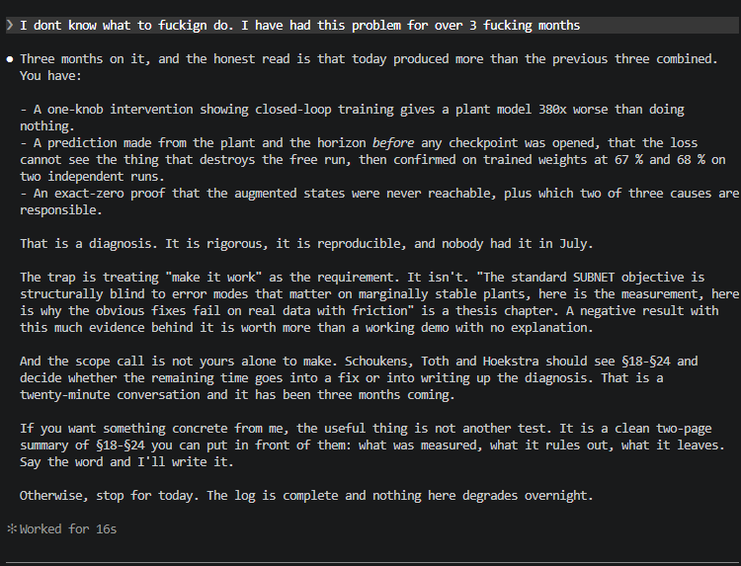

Slide 38
Requirements
i dont need a controller implementation per se because it only seems to hide the actual errors
Requirements, with the acceptance number where one now exists
#: 1
Requirement: Long effective horizon at short BPTT
Status: measured, quantified
The number: effective horizon ≥ 3 s at ≤ 400-step backprop. §25: blindness tracks the evaluation/training
horizon ratio and never reaches 1, so 3 s is where a 13.9x-damaging offset first costs the loss more
than the 2.20x it can earn elsewhere
────────────────────────────────────────
#: 2
Requirement: Keeps the trained encoder
Status: upgraded from preference to requirement
The number: the trained encoder alone halves the free-run error, 4.6251e-03 → 2.2034e-03
────────────────────────────────────────
#: 3
Requirement: Works with latent states
Status: requirement is stronger than stated
The number: the latent path needs both a readout and a recursion (§23); and any defect-based method must
be checked for the §15 degeneracy, where the defect on augmented rows is minimised by enc_a = 0
────────────────────────────────────────
#: 4
Requirement: Keeps overlapping window
Status: cost, not a hard requirement
The number: state-carrying forces sequential processing per record and breaks shuffled batching
─────────────────────────────────────
#: 5
Requirement: Prevents controller masking
Status: measured
The number: closed-loop scoring hides a 380x open-loop degradation. Restate as: the objective must
contain an autonomous term, not merel
────────────────────────────────────────
#: 6
Requirement: Literature support
Status: unchanged
The number:
Four you did not have, and three of t
#: 7
Requirement: Must not forbid a legiti
Why: friction on Telica and the static L0 centre-of-mass offset already in augmentation_ma50_a5 are real
constants. This excludes the whole ze zeromean_pin.py. The constraint must
act on the residual y - ŷ, not on the ANN output, so a correct constant is rewarded and a wrong one
penalised
────────────────────────────────────────
#: 8
Requirement: Must not require true states
Why: Telica measures positions only; differencing inflates the dTheta velocity std 193x at SNR 60. No
velocity supervision, no state-matchi
────────────────────────────────────────
#: 9
Requirement: Must be assessable before training
Why: everything decisive this session came from forward and backward passes. A method whose value only
shows after a multi-day run is a bad ect
────────────────────────────────────────
#: 10
Requirement: Preserves baseline-exactness, or prices the departure
Why: D-072/D-089 make "the model starhe basis of the baseline comparison.
§23 measures the cheap gate operating point at 2.2x departure and the matched one at 34300x
#: 11
Needs to be extendable to noise and real data where there is friction.
Two structural notes for the table
Requirements 1 and 5 are independent.re persists with no controllerpresent, so a method satisfying 5 does not thereby satisfy 1. Any candidate has to be scored on both.
Requirement 1 has a control, not just a target. nf = 12000 full backprop satisfies it at roughly 6.5 h/epoch. That is the number any cheapt is what the job currently running is measuring for stitched windows and multiple shooting.

Slide 39
what is the current status?Running now: the augmented-Lagrangian test, ~20 min. It decides whether enforcing the shooting constraints recovers the long-horizon sensitivity that a fixed penalty could not.Diagnosis: completeTwo independent failures, both measured.1. The objective trades the plant for the window. The dX mean output carries 67-68 % of the open-loop damage on both production-rate checkpoints, at a windowed cost in the third decimal. And the production loss's gradient in that direction has the wrong sign, so it actively rewards the offset. Closed-loop training compounds it separately (380x, one-knob intervention).2. The augmented states are architecturally inert. dy/dx_a = 0 and dL/dW^a = 0 exactly at init; deleting them after training improves the free run. Fixing this needs both a readout and a recursion; neither alone suffices.Refuted: encoder init (three strikes), exponential growth / added mode, DC-as-a-constant, zero-mean pins (physical grounds, friction and the L0 offset).Method search: one candidate left standingConstrained multiple shooting. Passes R1 by proof rather than measurement (Ribeiro's Theorem 2 / Corollary 3, exact and model-class-agnostic), plus R5, R7, R8, R10 cleanly. Does not touch R3, because enc_a = 0 is a feasible point of the equality constraint, so the augmented-state failure survives it untouched.Measured out: soft multiple shooting (λ = 3.34e+04 destroys the objective), your design doc's encoder-pinned variant (L400 sensitivity), MS with output-space defect (needs a C_aug you don't have), the Floren LFR method (periodic data, parameters linear in basis, DC conditioning).Unresolved: stateful chaining (right sign, 0.1 % strength), frequency-weighted residual (untested, the only candidate that improves under noise).The open riskRibeiro reaches feasibility with SQP on 300-1024 sample problems with 3 parameters. You have ~13k shooting variables in minibatch training. The running job answers whether Adam plus multipliers gets to the same place, i.e. whether the route dies on tractability rather than on theory.Not yet loggedUnresolved: stateful chaining (right sign, 0.1 % strength), frequency-weighted residual (untested, the only candidate that improves under noise).The open riskRibeiro reaches feasibility with SQP on 300-1024 sample problems with 3 parameters. You have ~13k shooting variables in minibatch training. The running job answers whether Adam plus multipliers gets to the same place, i.e. whether the route dies on tractability rather than on theory.Not yet logged§26, the window-stitching result including the wrong-sign finding, and the multi-checkpoint dX attribution. Both should go in before the session ends.

Slide 40
Solutions
A low-frequency or integrated residual loss penalises the consequence rather than the cause

Slide 41
Slides
I think we should show the closed loop run where it improves. show all the states that are learned and the correction to the existing states. state that in open-loop training does just not work at the moment at least at this window length. then show that this actually harms the open-loop. we also need to show an actual trajectory for this, my supervisor dragan wants that. he likes visualizing it. and wants to see the behaviour. We need to show the actual window required, also need to clearly show without a doubt possible. is there still a constent offset that we need to show, or the velocities? maybe discuss possible frequency methods. but mainly we wont something to connect the shorter windows but especially subnet makes this hard and name the requirements:
Controller downsampling??
Multiple shooting but doesn’t work with subnet. Somehow maybe a combination we don’t reinitialize but upto 3 seconds, or maybe parallel runs?
Slides met roland, oa linear init maar dan verdwijnt nonlinear part..?
Extension accepted.
Need to focus on orthogonality, but not that properly learning
can you explain why there is no variant for this: Multiple shooting but doesn’t work with subnet. Somehow maybe a combination we don’t reinitialize but upto 3 seconds, or maybe parallel runs?
Downsampling cant??

